Slide 1



Interactive Group Exercise
Roundtable Discussions on Procurement Lessons Sharing
(~45 minutes)
Please remain at your table.
Table facilitators will provide questions to discuss in an open dialogue format among the participants at your table.
Please share lessons from clean energy procurement processes that your company has conducted or challenges that have prevented clean energy action to date.

Slide 2
Interactive Exercise
DPPA Scenario Analysis (~60 minutes)
Please remain at your table.
Table facilitators will provide you with a resource packet containing case studies, description of roles, and key questions to facilitate the activity.
Collaborate with other participants to formulate a strategy, identify key terms and questions, and engage in a simulated DPPA negotiation.
Once the negotiation is complete, raise any remaining questions, or share challenges you experienced during the negotiation.

Slide 3
General Assumptions & Formula
Based on Decree 57/2025/ND-CP, the cost calculation parameters are assumed as follows:
Symbol | Unit | Assumed Value | Description
k |  | 1.026 | Adjustment coefficient
CDPPA_dv | VND/kWh | 360 | Power system service cost
Pcl | VND/kWh | 163.30 | Differential clearing fee
Kpp |  | 1.008 | Loss conversion coefficient at 110 kV voltage level
P1 | VND/kWh | 2,204 | Average retail electricity price
Cost Formulas
C_KH = C_EVN + C_CfD
=
=
(Pc − FMP) * Qc
Qkhhc * FMP * k * Kpp = C_DN
Qkhhc * C_dppa_dv = C_dppa
Qkhhc * Pcl = C_cl
(QKH − Qkhhc) * P1 = C_bl
+
+
+
Note: The plant sells all output to the spot market (receives FMP); the CfD only adjusts the price to Pc for the contracted volume Qc.

Slide 4
Scenario 1: The Base Case
Your manufacturing plant has a strict corporate target to reach 100% renewable energy consumption by 2030. To achieve this, your team wants to sign a DPPA via National Grid (Virtual DPPA) with a large solar developer.
Operational issue: Your factory doesn’t buy electricity directly from EVN. Instead, you pay your monthly electricity bill to the private Industrial Park Management Board, who buys bulk power from EVN and resells it to you through their internal grid.
Questions:
Under Decree 57, an Electricity Buyer must consume ≥200,000 kWh/month. If the IP lumps your factory into their master EVN meter, how do you accurately track and prove your specific energy use to qualify?
A standard Virtual PPA is a bilateral agreement (Between Buyer and Seller). However, since electricity delivery is controlled by the IP (Retailer), who actually needs to be at the negotiation table to make this work?
What happens if the IP demands a new, non-negotiable "infrastructure fee" to facilitate this DPPA setup? How does that impact your budget forecasting and management buy-in over a typical 15-to-20-year PPA Contract Term?

Slide 5



Scenario 1: The Base Case
Consumption = DPPA Volume (1)
Solar Plant 45MW
Difference Q_{KH} - Q_{KHhc} = 0 MWh
The customer doesn’t need additional electricity from EVN
Q_khhc = 5,000 MWh/month
5-Line Bill
1. Market electricity energy cost
C_{DN} = 5,000,000 kWh * 1,150 VND/kWh * 1.026 * 1.008 = 5,946,696,000 VND
2. System service fee
C_{DPPA} = 5,000,000 kWh * 360 VND/kWh = 1,800,000,000 VND
3. Difference clearing fee
C_{CL} = 5,000,000 kWh * 163.30 VND/kWh = 816,500,000 VND
4. Additional electricity purchase
C_{BL}= (QKH - Qkhhc)* P1 = 0 kWh * 2,204 VND/kWh = 0 VND
CfD
QC = 5,000 MWh/month
PC = 1,250 VND/kWh
FMP = 1,150 VND/kWh
Q_KH = 5,000 MWh/month
Large Customer
Total cost collected by EVN
C_{EVN} = 5,946,696,000 + 1,800,000,000 + 816,500,000 + 0 = 8,563,196,000 VND

Slide 6
Scenario 1: The Base Case
Consumption = DPPA Volume (2)
Solar Plant 45MW
5. CfD Contract Cost
C_{DN} = (PC - FMP) * QC = (1,250 - 1,150) VND/kWh * 5,000,000 kWh = 500,000,000 VND
Q_khhc = 5,000 MWh/month
Total Customer Cost (C_{KH} )
C_{KH} = C_{EVN} + C_{CfD} = 8,563,196,000 + 500,000,000 = 9,063,196,000 VND
CfD
QC = 5,000 MWh/month
PC = 1,250 VND/kWh
FMP = 1,150 VND/kWh
Power Plant Revenue
Revenue from the market
C_{TTD}: The plant generates the full 5,000 MWh (after loss ~5,040,000 kWh at the generator) C_{TTD}= (Qm * FMP) = 5,040,000 kWh * 1,150 VND/kWh = 5,796,000,000 VND
Revenue from CfD contract
C_{CfD} = QC * (PC - FMP) = 5,000,000 kWh * (1,250 - 1,150) = 500,000,000 VND
Total plant revenue is 5,796,000,000 + 500,000,000 = 6,296,000,000 VND
Q_KH = 5,000 MWh/month
Large Customer

Slide 7

Scenario 1: The Base Case
Consumption = DPPA Volume (3)
8.5 billion VND = 5,9 billion VND for market electricity energy
+ 1,8 billion VND service fee
+ 0.8 billion VND difference fee
+ 0 VND additional electricity purchase fee
Large Customer
EVN
0.5 billion VND according to the CfD contract
5.8 billion VND on the spot market
RE GENCO

Slide 8
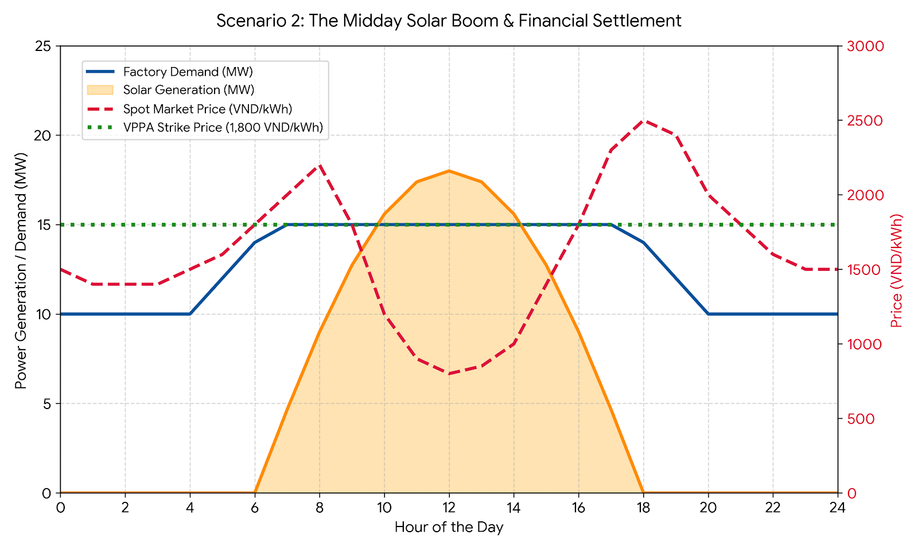
Scenario 2: The "Duck Curve" & Price Crashes
Your factory agrees to a Virtual DPPA (grid-connected) with a solar developer
Fixed "Strike Price" of 1,800 VND/kWh.
Factory continues to pay local utility for the physical electricity you consume to keep the machines running.
Factory & developer settle the difference between the Strike Price & the wholesale spot market floating price (FMP)
Sunny month: solar energy floods the national grid & the midday FMP drops to 800 VND/kWh.
Questions:
Who owes money to whom? Since you are essentially paying two bills, how does this complicate your factory's monthly operational costs?
Imagine a severe heat wave causes a power shortage, and the FMP spikes to 2,500 VND/kWh. How does the VPPA financially protect your factory's budget in this situation?
If EVN raises the DPPA fees next year, your overall energy costs go up. How do you communicate this ongoing regulatory risk to your CFO for DPPA approval?

Slide 9

Scenario 3
Actual Consumption Exceeds Contract Output (1)
Wind Plant 30MW
Difference Q_{KH} - Q_{KHhc} = 1000 MWh
The customer must purchase additional electricity from EVN
Actual Delivered Quantity = 8,000 MWh/month
1. Market electricity energy cost
C_{DN} = 8,000,000 kWh * 1,600 VND/kWh * 1.026 * 1.008 = 13,237,862,400 VND
2. System service fee
C_{DPPA} = 8,000,000 kWh * 360 VND/kWh = 2,880,000,000 VND
3. Difference clearing fee
C_{CL} = 8,000,000 kWh * 163.30 VND/kWh = 1,306,400,000 VND
4. Additional electricity purchase
C_{BL}= (QKH - Qkhhc)* P1 = 1,000,000 kWh * 2,204 VND/kWh = 2,204,000,000 VND
CfD
QC = 8,000 MWh/month
PC = 1,500 VND/kWh
FMP = 1,600 VND/kWh
Consumption = 9,000 MWh/month
Total cost collected by EVN
C_{EVN} = 13,237,862,400 + 2,880,000,000 + 1,306,400,000 + 2,204,000,000 = 19,628,262,400 VND
Large Customer

Slide 10
Scenario 3
Actual Consumption Exceeds Contract Output (2)
Wind Plant 30MW
5. CfD Contract Cost
C_{DN} = (PC - FMP) * QC = (1,500 - 1,600) VND/kWh * 8,000,000 kWh = -800,000,000 VND
Actual Delivered Quantity = 8,000 MWh/month
Total Customer Cost (C_{KH} )
C_{KH} = C_{EVN} + C_{CfD} = 19,628,262,400 + (-800,000,000) = 18,828,262,400 VND
CfD
QC = 8,000 MWh/month
PC = 1,500 VND/kWh
FMP = 1,600 VND/kWh
Power Plant Revenue
Revenue from the market
C_{TTD}: The plant generates the full 8,000 MWh (after loss ~8,064,000 kWh at the generator) C_{TTD}= 8,064,000 kWh * 1,600 VND/kWh = 12,902,400,000 VND
Revenue from CfD contract
C_{CfD} = QC * (PC - FMP) = 8,000,000 kWh * (1,500 - 1,600) = -800,000,000 VND
Total plant revenue is 12,902,400,000 + (-800,000,000) = 12,102,400,000 VND
Consumption = 9,000 MWh/month
Large Customer

Slide 11

Scenario 3
Actual Consumption Exceeds Contract Output (3)
19.628 billion VND = 13.238 billion for market electricity energy
+ 2.880 billion service fee
+ 1.306 billion difference fee
+ 2.204 billion additional electricity purchase fee
Large Customer
EVN
0.800 billion VND according to the CfD contract
12.902 billion VND on the spot market
RE GENCO

